Slide 1





Adaptive Antenna Matching
Senior Design Project
Student names: James Weaver, Jessie Lopez, Gilberto Cornejo
Sonoma State University Department of Engineering Science
Advisor: Mohamed Salem
Industry Advisor: Mr. Chris Stewart, founder of Pocket Radar Inc. and Invention Planet, LLC
Client: TBD
Date: 4/18/25
ourwebpage.TBD.com
weaverja@sonoma.edu
lopezjesu@sonoma.edu
cornejog@sonoma.edu

Slide 2
Overview
Problem Statement, Value Proposition, Existing Solutions
Proposed Solution
Marketing and Engineering Requirements
Hardware Block Diagram
Impedance Matching Overview
DACs and Voltage Translation Circuit
Frequency Scaled Proposed Solution/Testing
Design Matrices
Summary of Tests
Challenges and Risks
Budget and Materials
Schedule
Supporting Courses

Slide 3
Overview
Project Introduction
  Problem Statement
  Value Proposition
  Existing Solutions/Proposed Solution
  Marketing and Engineering Requirements
  Challenges and Risks
  Estimated Scheduling/Budget
Hardware Overview
  Matching Network
    Impedance matching overview, varactor diodes
  DACs and I2C
  Voltage Translation Circuit
  Software Defined Radio

Slide 4
Overview
Testing
  Antenna Characteristics
  Varactor SRF simulation
  Scaled model testing
  PCB design, components, and troubleshooting
  Response time
  DAC accuracy
  VTC accuracy
  SDR accuracy
  Algorithm development and simulation

Slide 5
Overview
Final Product and Results
  Engineering Requirements
  Review of Engineering Challenges
  Actual Scheduling and Budget

Slide 6
Problem Statement
The problem we are exploring addresses manufacturers of wireless devices. A strong wireless signal relies on a well-matched antenna, as poor matching can cause power to reflect back toward the transmitter. Environmental factors, such as proximity to the body, can disrupt the matching of the antenna and degrade its performance.

Slide 7
Value Proposition
Our Adaptive Antenna Matching design, demonstrated at 1.8 GHz, dynamically adjusts the impedance match to maintain optimal signal strength and power transfer, even in environments where antenna performance may be affected, resulting in an improved signal-to-noise ratio and greater efficiency.

Slide 8
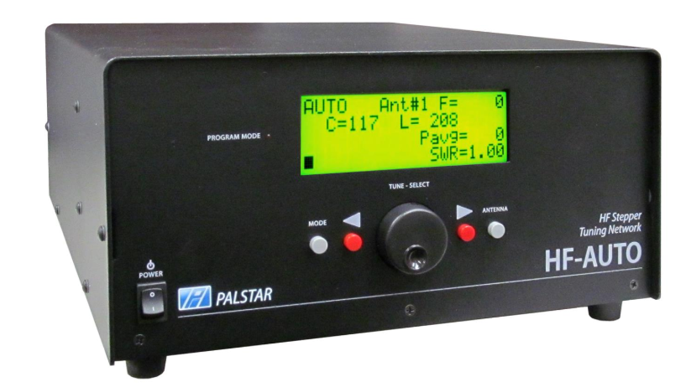
Existing Solutions
Pros:
off-the-shelf readily available
Cons:
Size, Cost, Low-Frequency, High Power, Slow Tuning Speed
Palstar HF-Auto 1800 W (1.8 - 54 MHz)

Slide 9
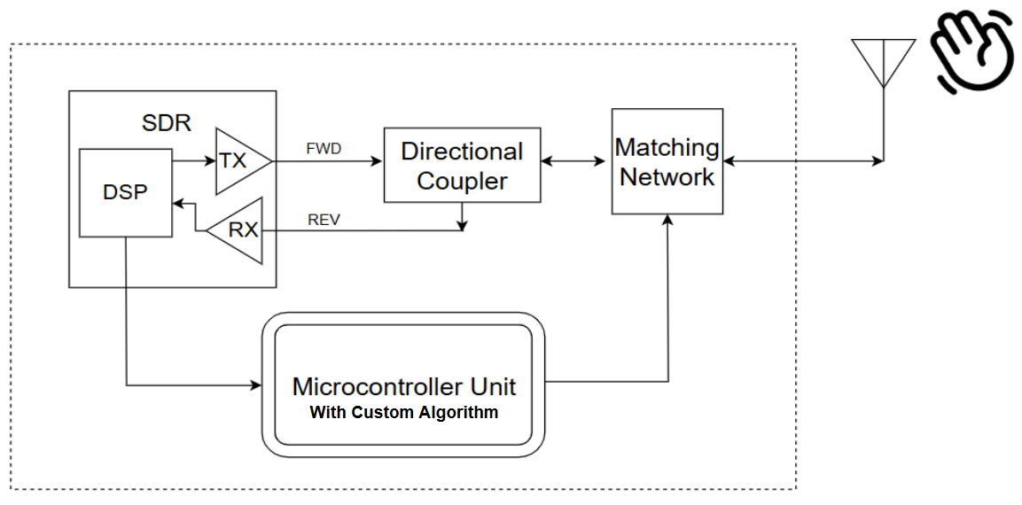
Basic Implementation of our System
VERY high-level block diagram
Proposed Solution
Notes:
Make sure to mention how we are not actually using a real BT device in this project. Also mention that we are including the “hand” (which represents any sort of external object) as part of the system.

Slide 10
Marketing Requirements
1. The device shall continuously adapt to changes in the impedance of the antenna.
2. The device shall not consume a significant amount of power to operate.
3.The device shall have no user intervention for adaptive features to operate.
4. The device shall respond to changes in impedance with minimal delay.
5. The device shall operate within the center of the 1.8 GHz range.
6. The device shall not create more insertion loss in RF path than what is saved.

Slide 11
Engineering Requirements
1. The device must be able to match a load impedance with a starting VSWR of 2.0 or less to within a VSWR of 1.22 (at least 20 dB return loss). (MR1)
2. The device (all components excluding the SDR) must have a power consumption of less than 700 mW during operation. (MR2)
3.The device must be able to make adjustments autonomously when in operation. (MR3)
4. The device must respond to changes in impedance within 100ms to ensure minimal delay in performance. (MR4)
5. The device must operate effectively at a frequency of 1.80 GHz. (MR5)
6. The insertion loss of the matching network must be less than 2 dB. (MR6)
Notes:
For ER 5, make sure that you mention the challenges of operating a matching network at such high frequencies.

Slide 12
Challenges and Risks
Challenges:
Designing a matching network that works at microwave frequencies.
Designing an adaptive algorithm that responds within an acceptable time.
Minimizing insertion loss.
Configuring the SDR to operate in full-duplex mode and interface with MCU.

Slide 13
Challenges and Risks
Risks | Qualitative Risk Score | Mitigation Plan | Contingency Plan
Unpredictable behavior at microwave frequencies. | Likelihood = 4 (likely) Consequences = 4 (major) Total = 16 (Extreme) | Use high-quality RF components rated for microwave frequencies. Simulate the network extensively in software. | If performance issues persist, redesign the network with alternative components or configurations.
System latency may hinder the adaptive system's real-time response. | Likelihood = 4 (likely) Consequences = 4 (major) Total = 16 (Extreme) | Thoroughly test the algorithm in simulation and simplify it as much as possible. | Redesign the algorithm
System losses are greater than what is saved | Likelihood = 2 (unlikely) Consequences = 3 (moderate) Total = 6 (moderate) | Test directional coupler directly and in series with matching network | Purchase higher-quality directional coupler
Device draws more power due to unforeseen scenarios | Likelihood = 3 (possible) Consequences = 4 (major) Total = 12 (High) | Use power-efficient components. | Redesign system with different components

Slide 14
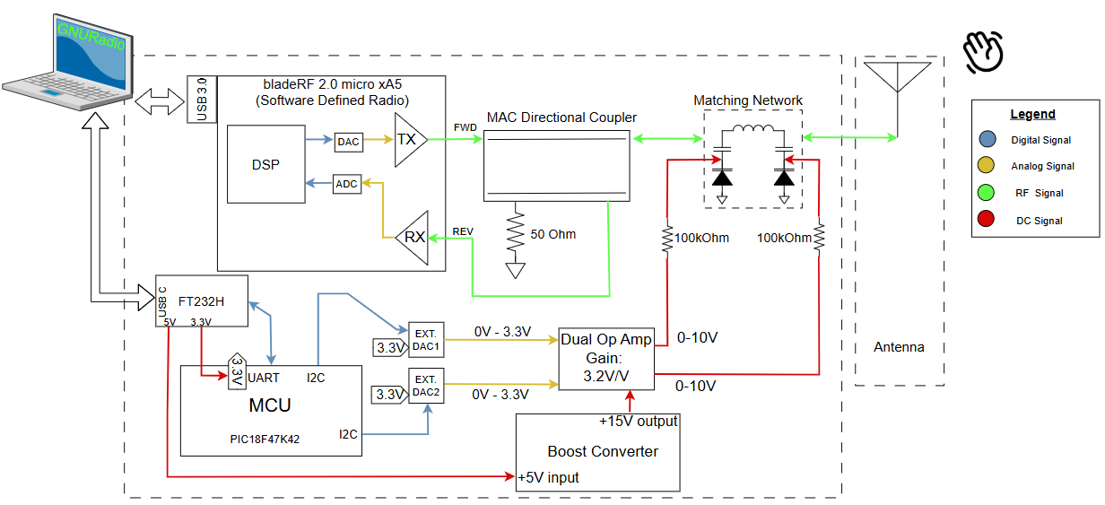
Hardware Block Diagram

Slide 15
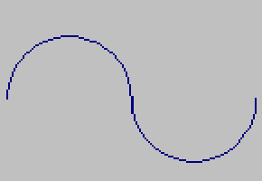
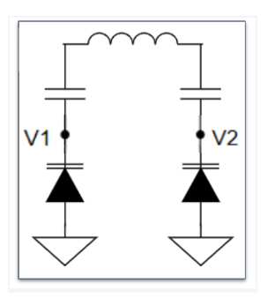
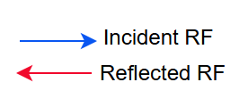
How Does A Matching Network Work ?
Matching Network
Notes:
Mention how a matching network can assume many different topologies, not just a Pi. Should also make clear RF input and output.
“The objective of impedance matching is to configure the matching network such that the combined impedance of the matching network and the load presents an impedance to the generator equal to the characteristic impedance of the transmission line.”

Slide 16
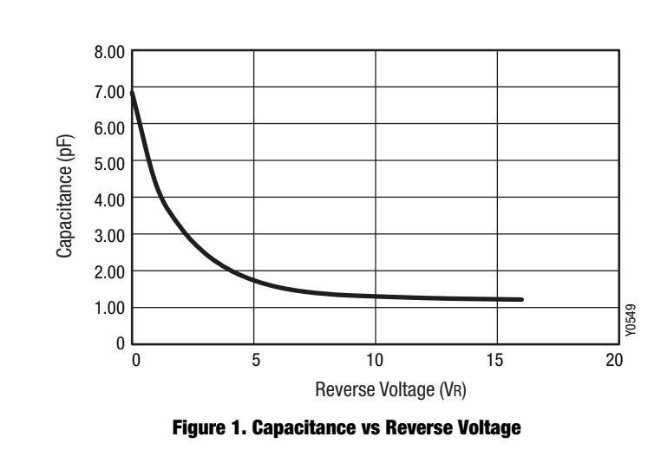
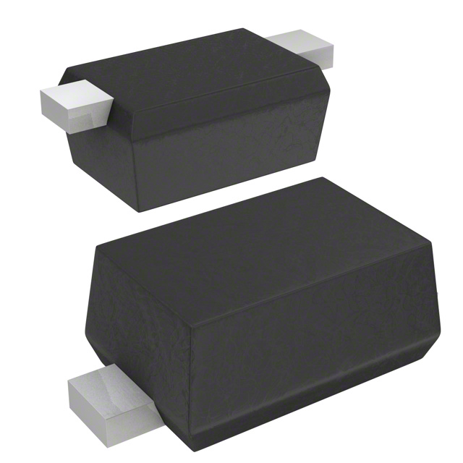
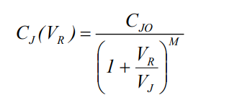

What is a Varactor Diode?
Varactor Diodes
Notes:
Make sure to mention that a varactor diode is always reverse biased - not meant to conduct.
This shows the capacitance vs reverse voltage graph for the SMV1276-079LF CONTINUOUS FUNCTION
Mention that everything besides VR is a constant, defined on datasheet

Slide 17
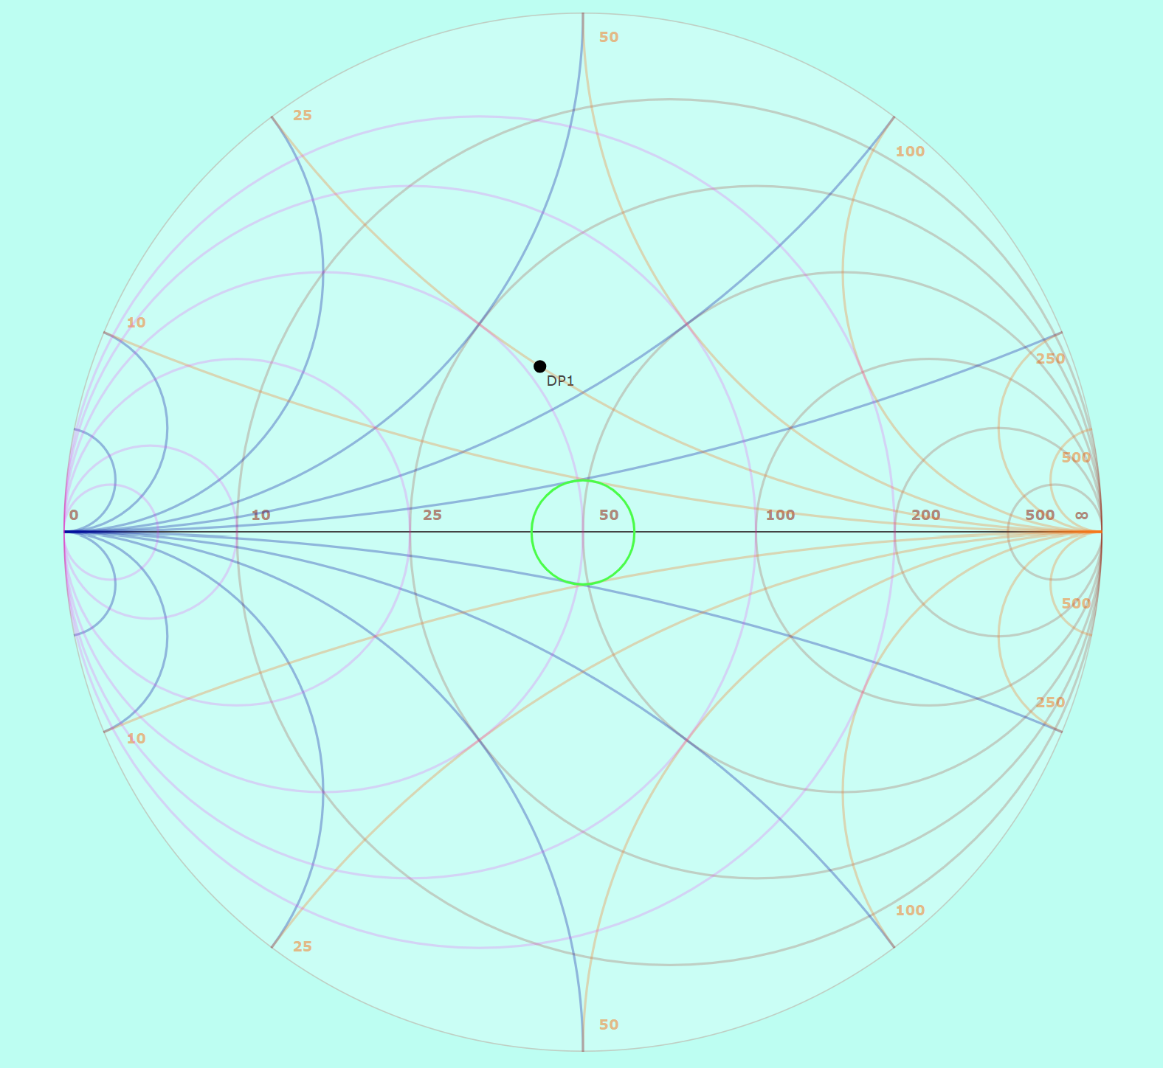
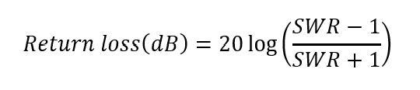


Matching Network Example
Notes:
Also note the vswr=1.22 circle that corresponds to a return loss of 20dB.
Briefly explain what a smith chart is
make sure to mention how shunt C moves down CW, series L moves up CCW

Slide 18
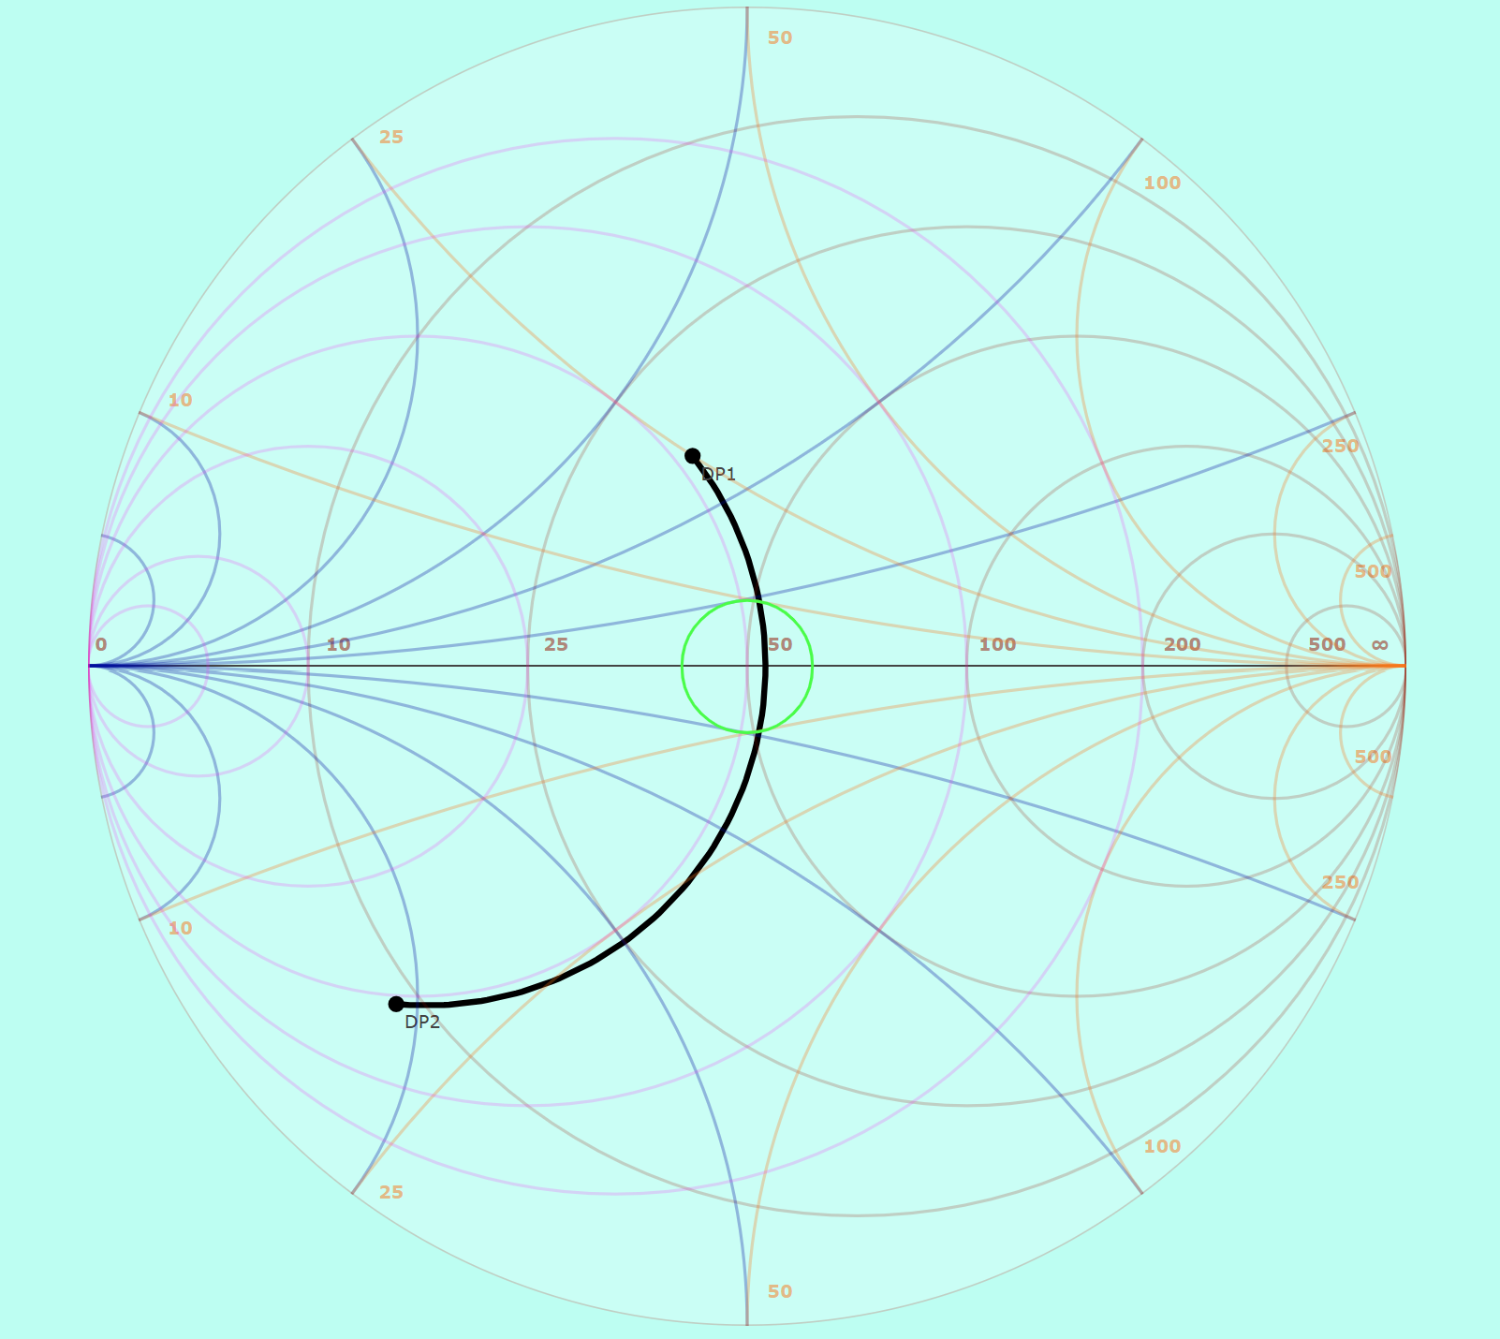
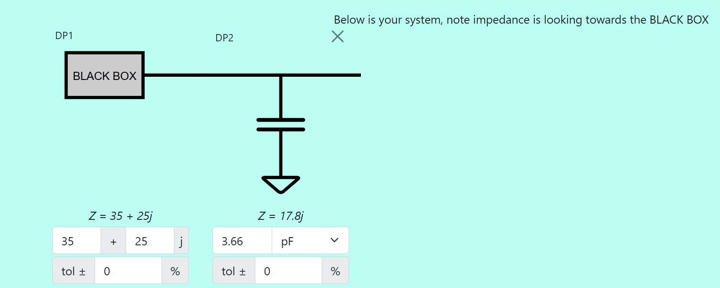

Matching Network Example

Slide 19
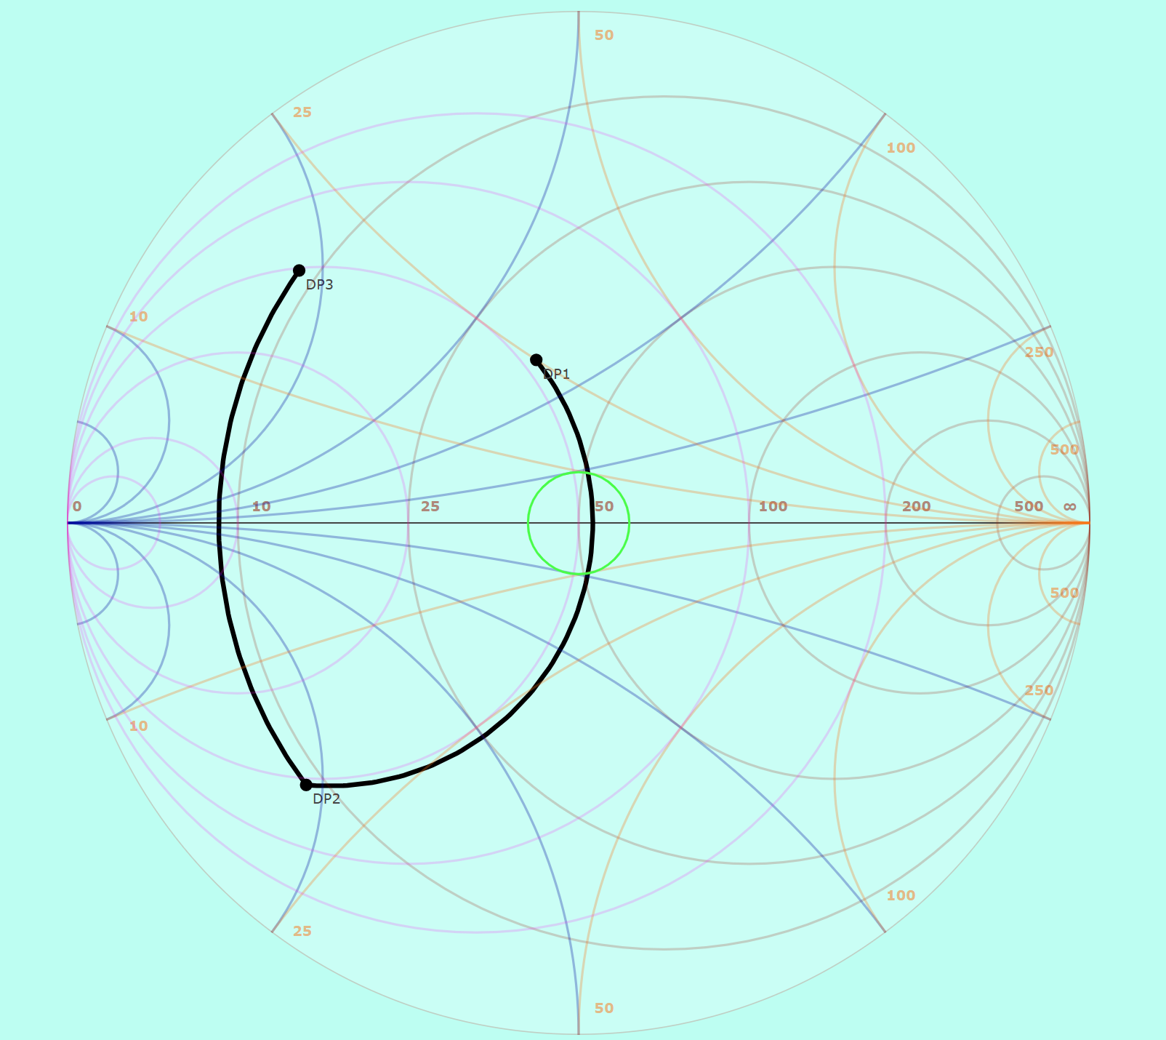
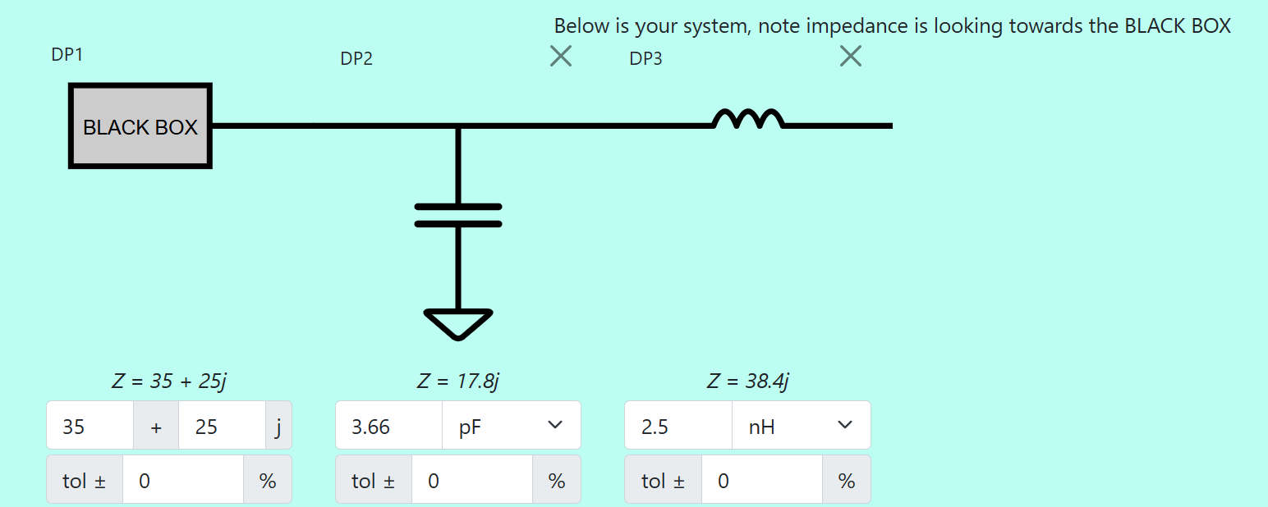

Matching Network Example

Slide 20
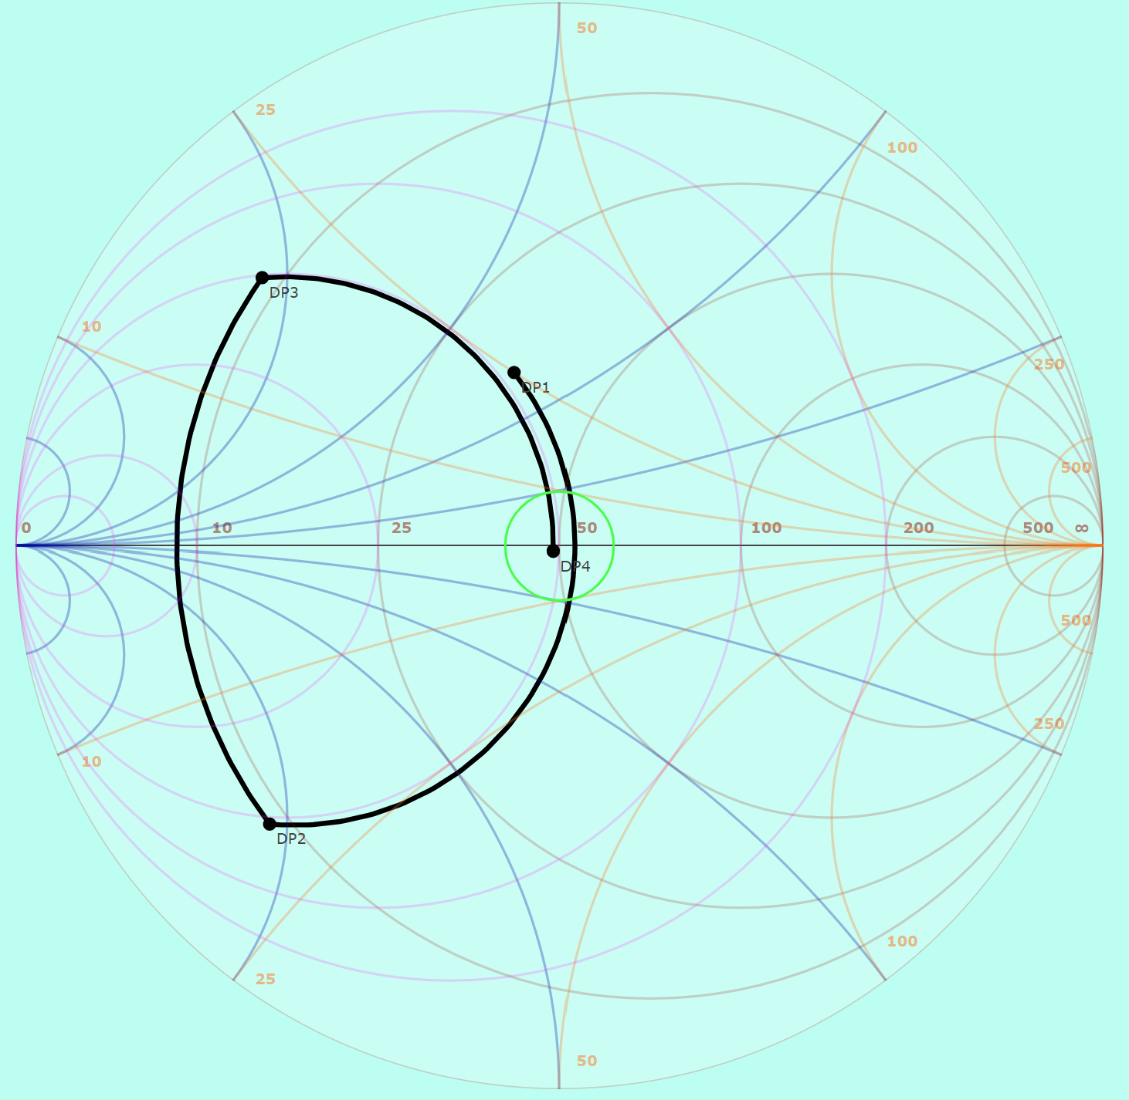
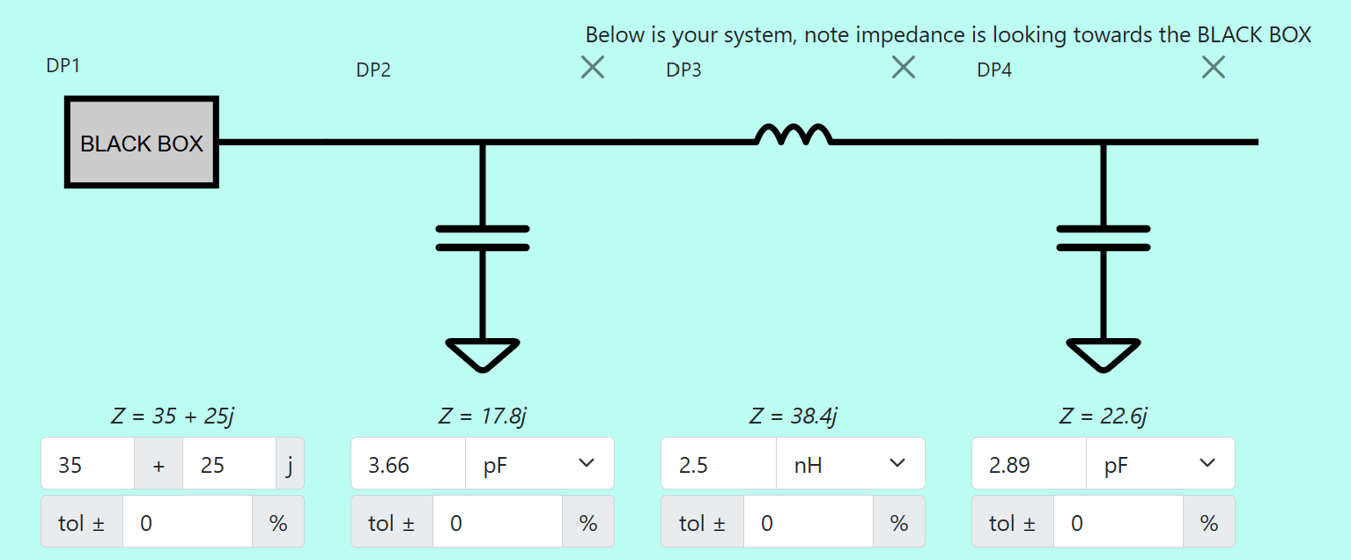

Matching Network Example

Slide 21
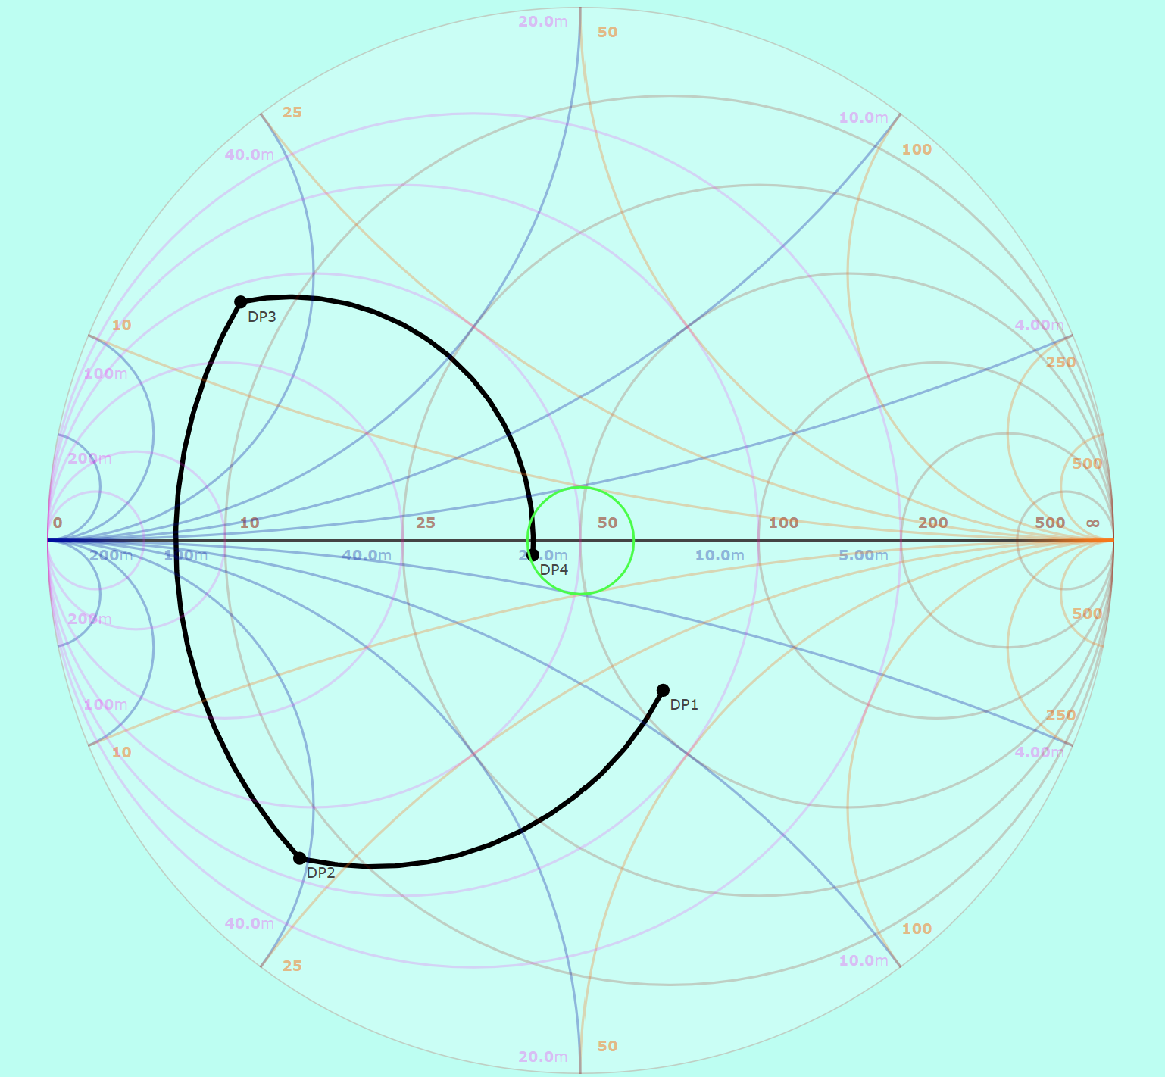
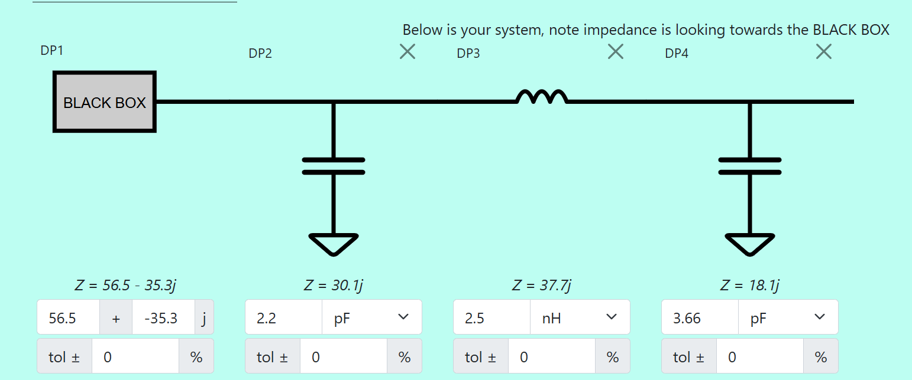

Matching Network Example
Notes:
Mention how the impedance chosen was based off the “worst case scenario” from the collected data (56.5-35.3J), VSWR = 1.94, rl = 9.9dB
Also note the vswr=1.22 circle that corresponds to a return loss of 20dB.

Slide 22
Hardware Block Diagram

Slide 23
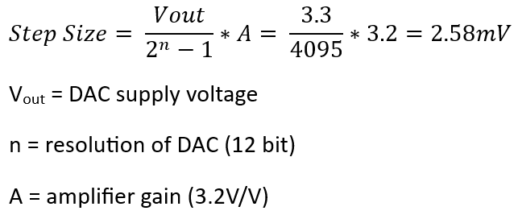
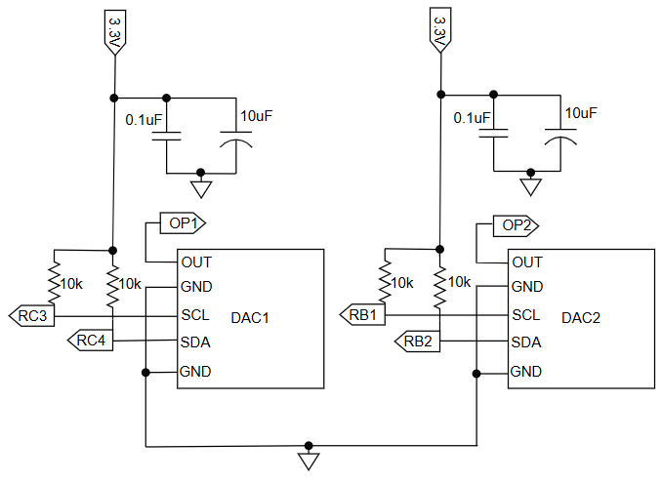
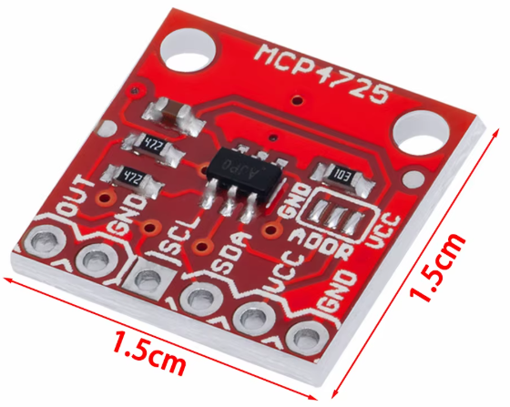
Programming the DACs with I²C Protocol
Power Consumption for two = 2.64mW

Slide 24
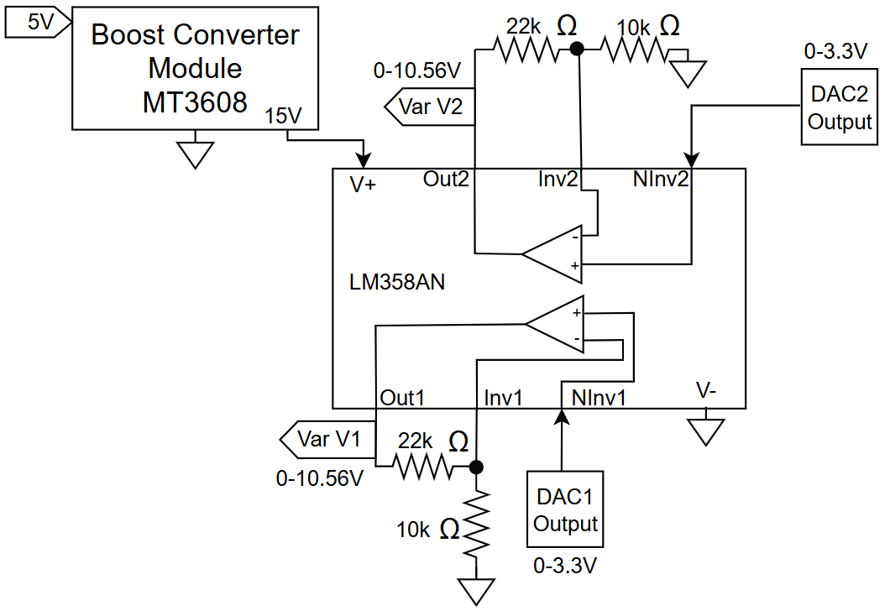
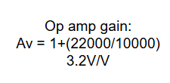
Voltage Translation Circuit Design

Slide 25
Hardware Block Diagram

Slide 26
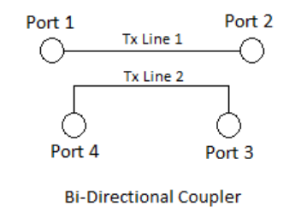



Directional Coupler
Passive device that uses electromagnetic coupling to sample a portion of either the forward or reflected signal
Coupling Factor -
Insertion Loss -
Directivity -
Measured w/ FieldFox
RF Input
RF Output
16.80dB +/-0.09dB
Coupled
Isolated
0.25dB +/-0.09dB
34.74dB +/-0.09dB

Slide 27
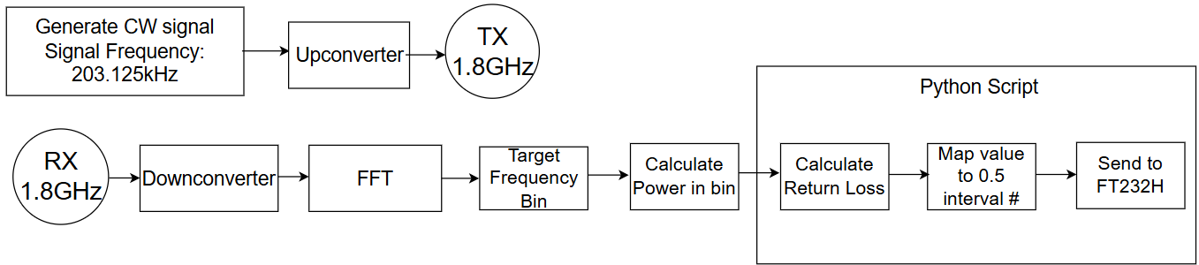


Software Defined Radio (SDR)

Slide 28
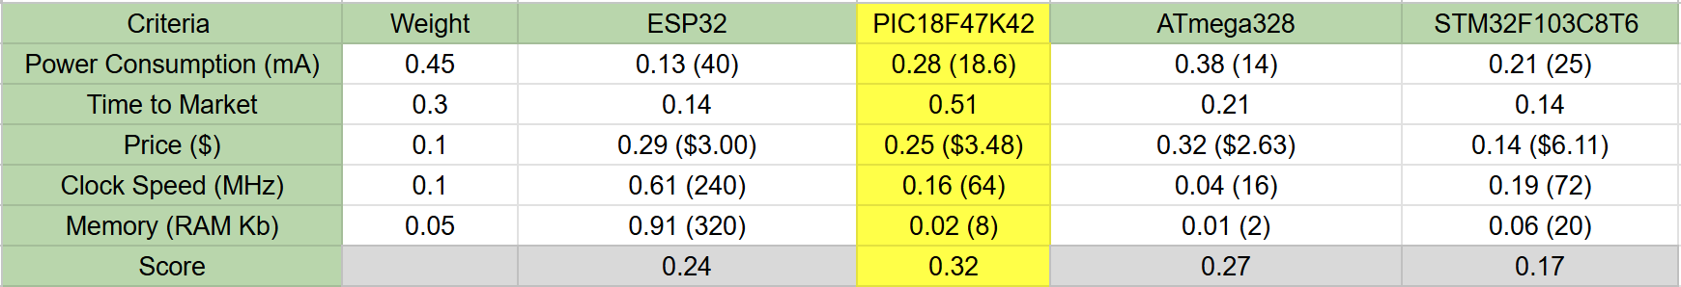
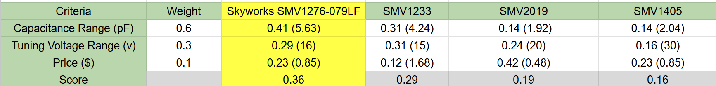
Decision Matrices
MCU:
Varactor:

Slide 29
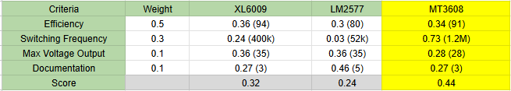
Decision Matrices Cont.
Boost Converter:

Slide 30
Summary of Tests Conducted
Test Number | Test Objective | Related ER | Status | Notes
FT.1 | Testing of the antenna | ER.1 | Complete
FT.2 | Measure/simulate the self-resonant frequency of reactive components | ER.1, ER.3, ER.5 | Complete | Expected >1.8 GHz
FT.3 | Testing of the matching network | ER.1, ER.3 | Complete
FT.4 | Testing of the DACs | ER.2, ER.4 | Complete | DAC outputs were <0.5% from expected
FT.5 | Testing the voltage translation circuit | ER.2 | Complete
FT.6 | Test microcontroller algorithm | ER.1, ER.3 | Complete | Expected return loss of no less than 20dB

Slide 31
Summary of Tests Conducted (cont.)
Test Number | Test Objective | Related ER | Status | Notes
FT.7 | Testing SDR can measure return loss | ER.1, ER.5 | Complete
ST.1 | Measure the total power consumption | ER.2 | Complete | Use a multimeter to measure the system power
ST.2 | Determine how long the device takes to match an impedance | ER.4 | Complete | Analyze output on scope

Slide 32
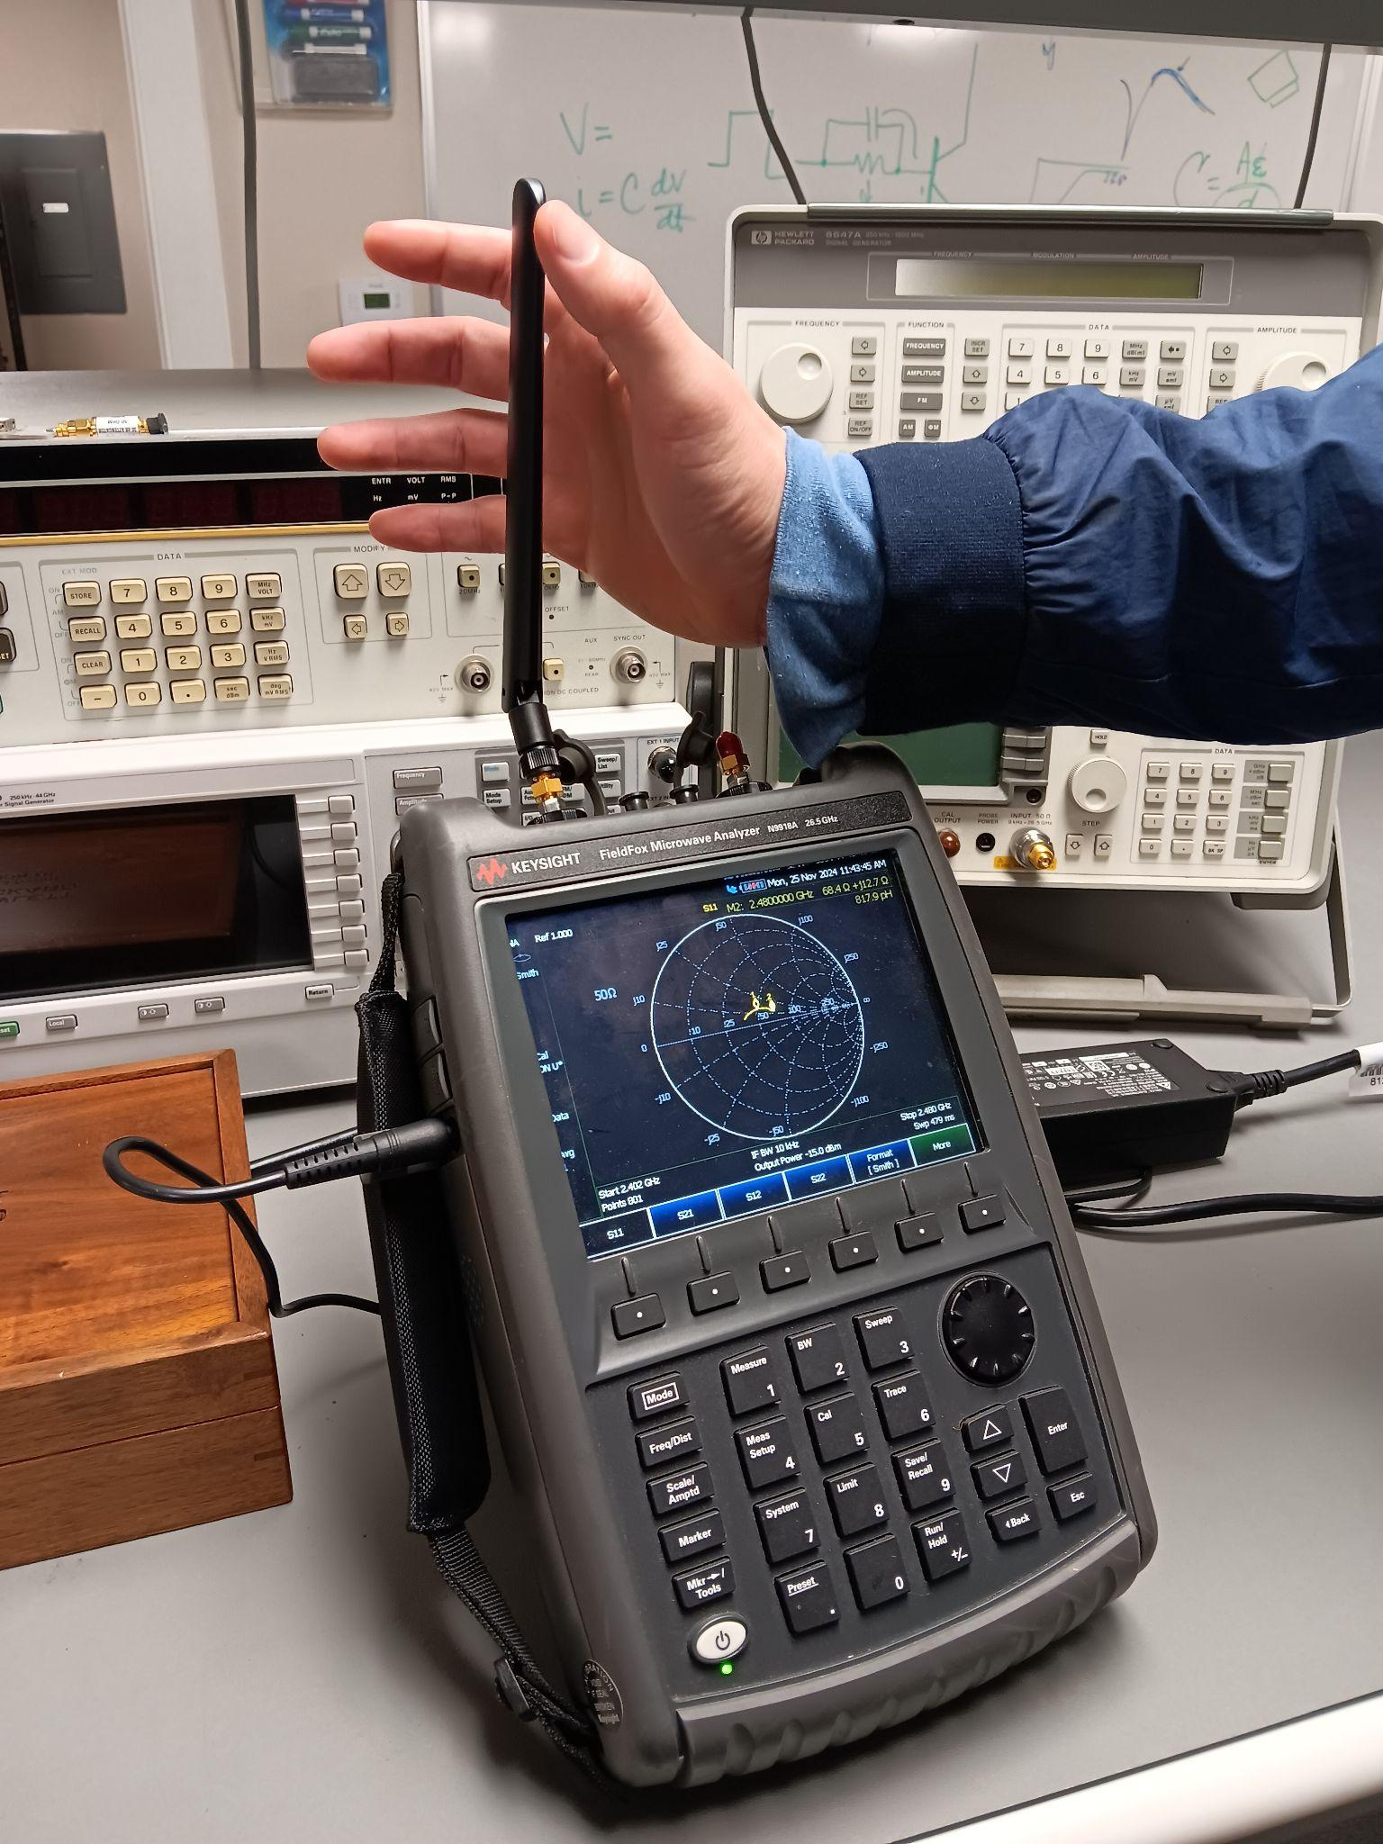
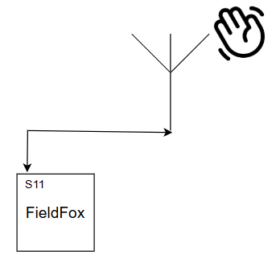
Antenna Characteristics (FT.1)
Antenna Testing @ 1.8 GHz (S11)
Notes:
Our system, in theory, should optimize the performance of any BT device, but our project is tailored to the Linx ANT-W63WS4 antenna.

Slide 33
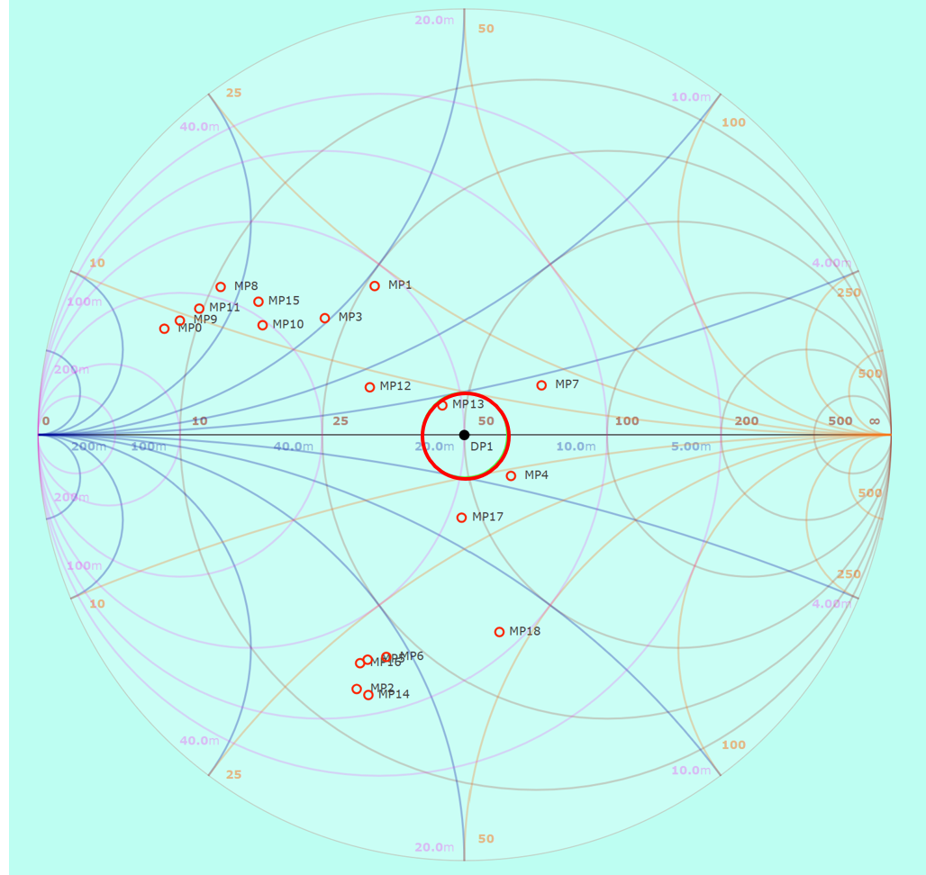
Antenna Impedance
Notes:
make sure to mention that worst point was SWR=1.94 / RL=9.9dB

Slide 34
Stray Reactances
Simply put, strays in RF are reactances that arise from the non-idealistic nature of real components.
Usually undesirable as they are difficult to model and hard to predict; dependent on frequency, material, geometry, etc…
Self-resonance is a direct consequence of strays, and refers to the frequency at which all reactive contributions to the impedance sum to zero (Z_{im} = 0). Generally want components to operate well below SRF.

Slide 35
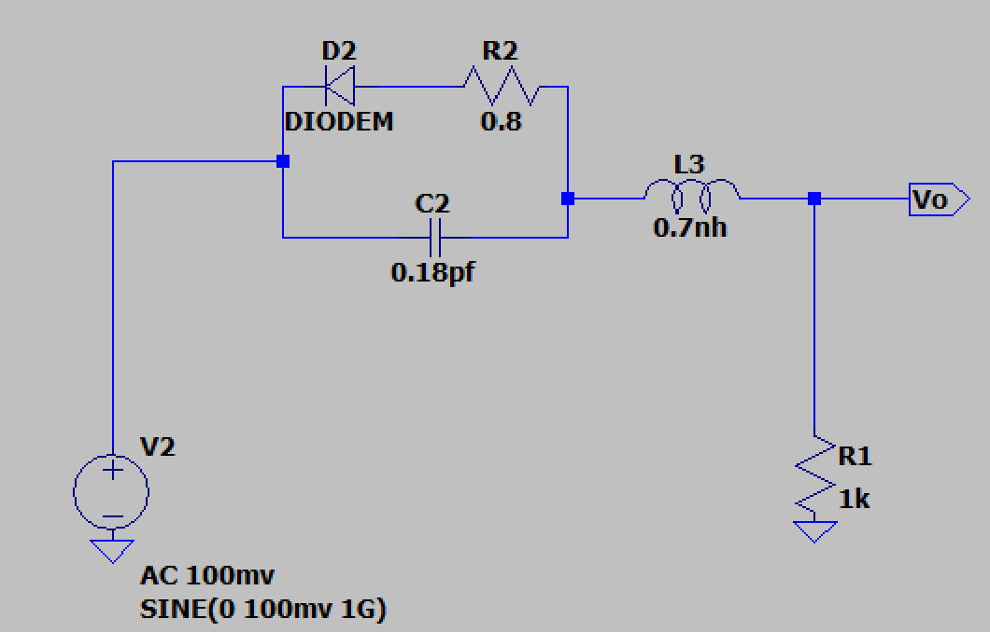
Self-Resonance Simulation (FT.2)
AC decade sweep, 50MHz to 5GHz. 100mv source. Zero RBV.
All models and values taken directly from the SMV1276-079LF datasheet.
Cathode
Anode
Notes:
impractical to directly test SRF of individual components. Can use models provided by manufacturers.

Slide 36
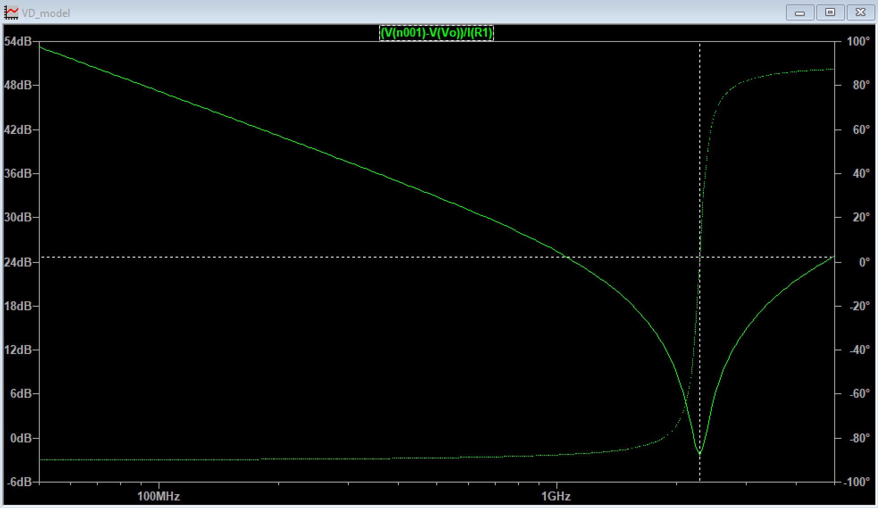
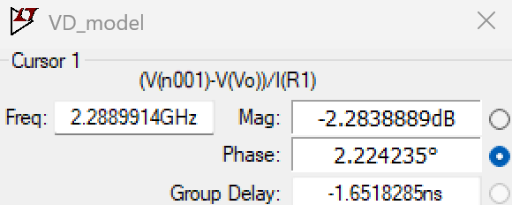
Self-Resonance Simulation - Results (FT.2)
Results show self-resonance occurring at a much lower frequency than ideal; about 2.28 GHz. Mainly the result of package inductance.
Notes:
mention that the phase is positive, so its not even a cap anymore, but an L.
mention how ideal capacitor just keeps getting smaller impedance, phase stays -90
m

Slide 37
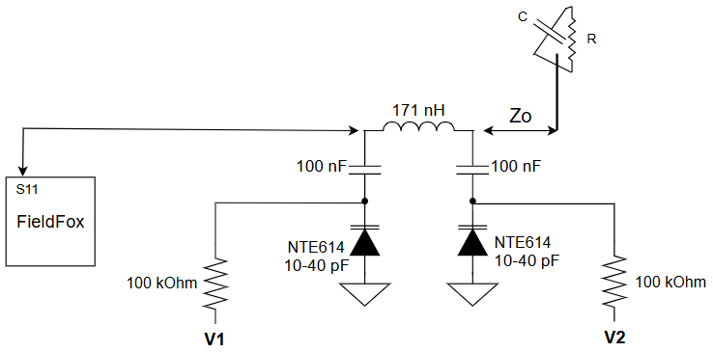
Basic Implementation of our System @ 30 MHz
VERY high-level block diagram
Testing of the Matching Network Frequency Scaled Version (FT.3)
Notes:
Purpose is to start developing an algorithm without the complications that come along with higher frequencies. Also mention that we built a scaled matching network but had to build another one using the “deadbug” method.

Slide 38
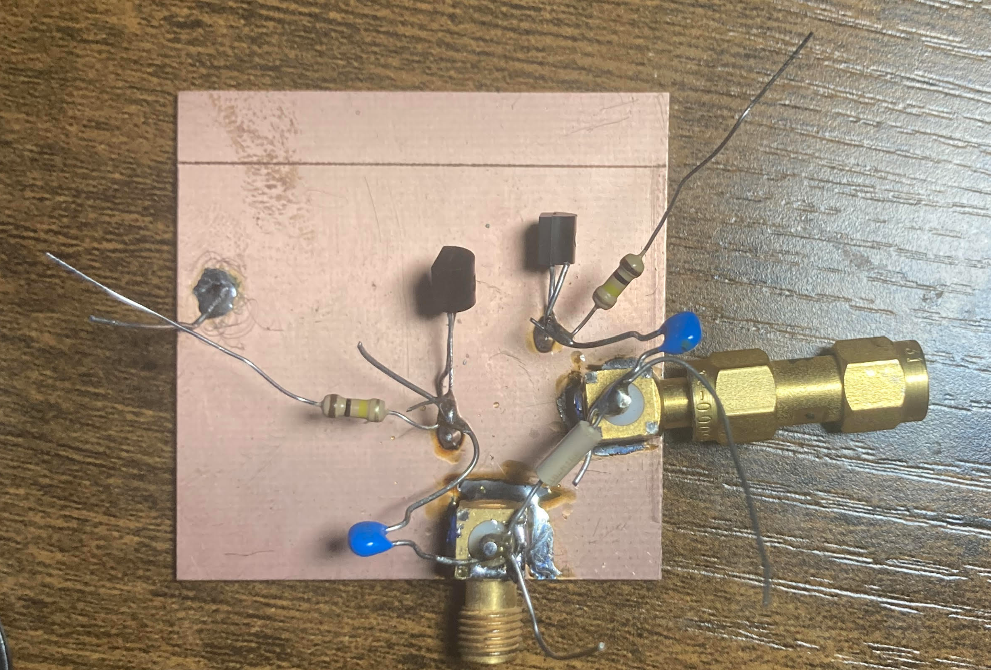
Scaled Version
Varactors
V2
V1
DC blocking
capacitors
Notes:
Purpose is to start developing an algorithm without the complications that come along with higher frequencies. Also mention that we built a scaled matching network but had to build another one using the “deadbug” method.
ALSO MENTION THE FIRST ONE YOU BUILT THAT DIDNT WORK

Slide 39
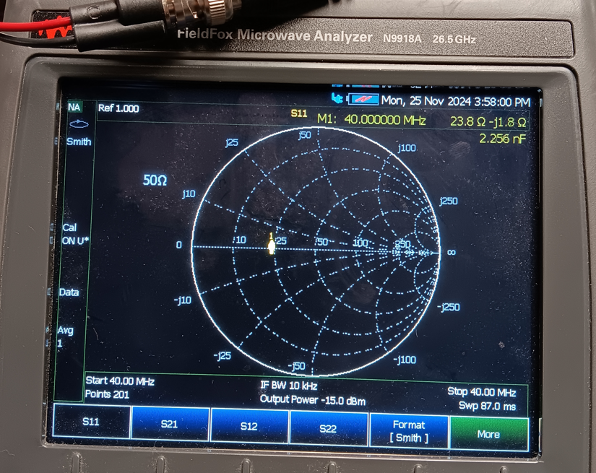
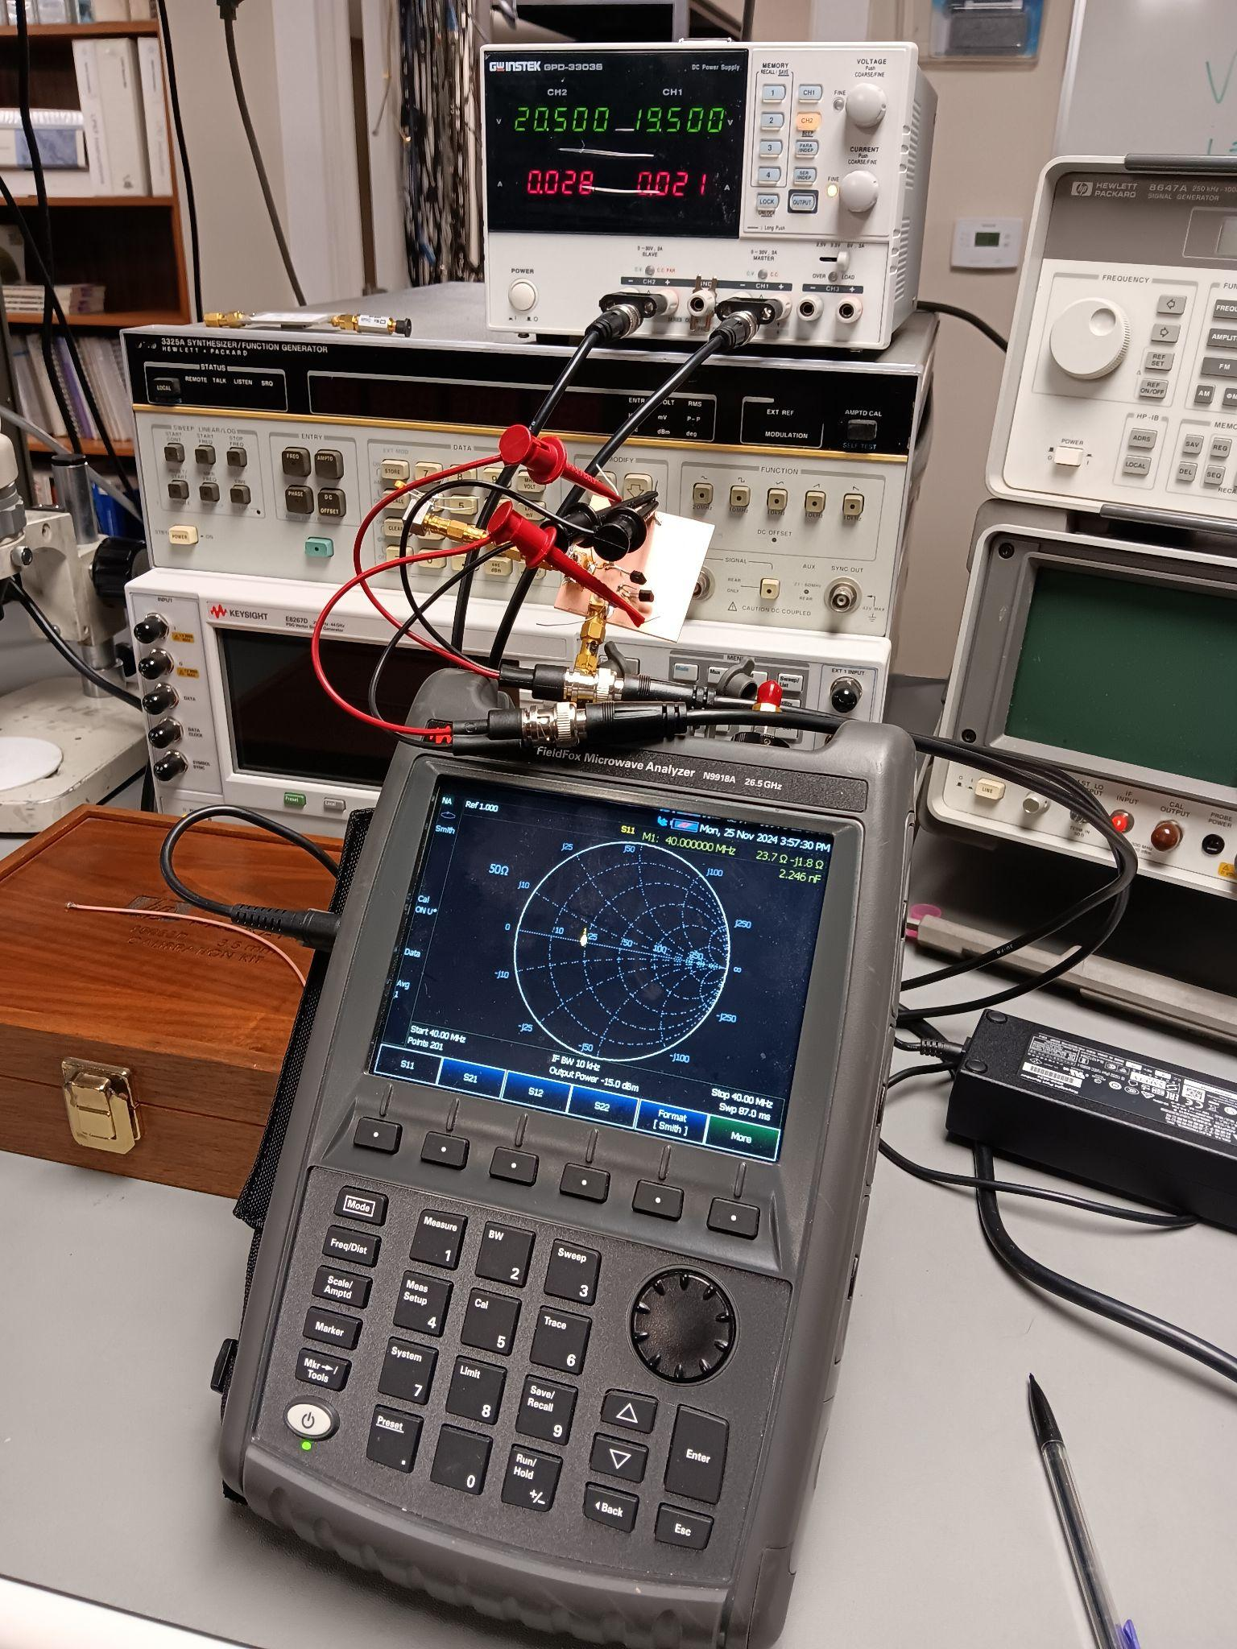
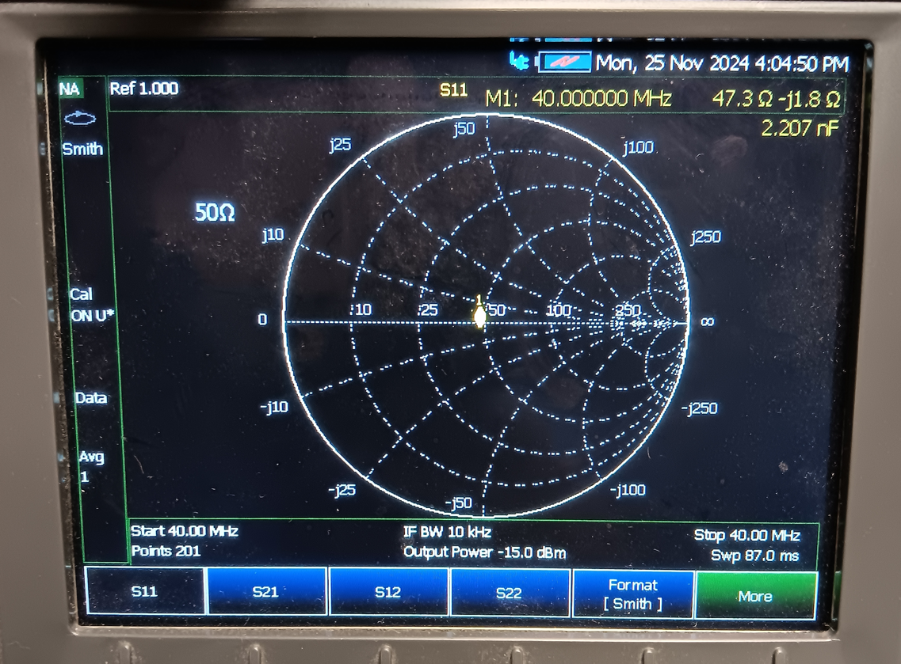
Scaled Version Results
← Unmatched
← Matched
Notes:
make sure to mention at 30 MHz

Slide 40
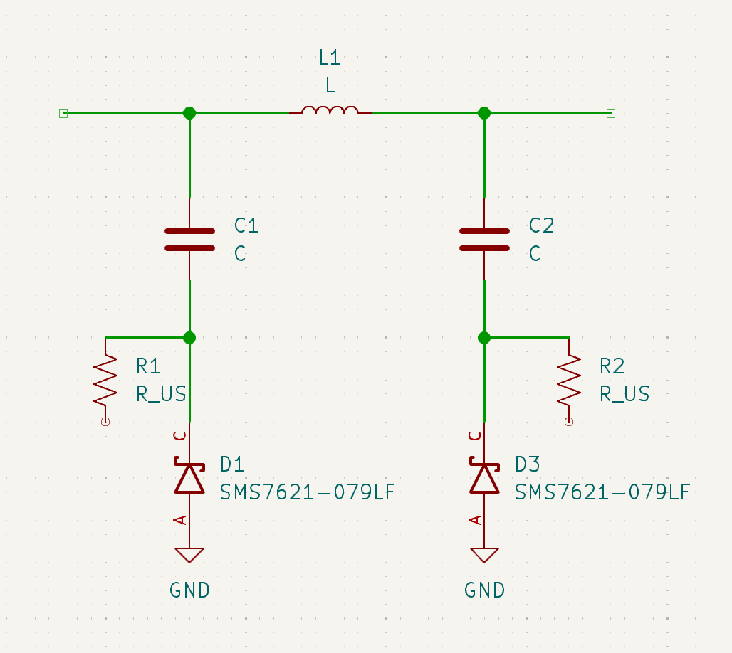
Matching Network Schematic
Typical PI network that is commonly used in RF designs.
Notes:
mention here how the previous slides (the dead bug slides) talk about the dead bug circuit which was constructed “hastily” to get an idea of how matching occurs. Now, its time to talk about the ACTUAL matching network.

Slide 41
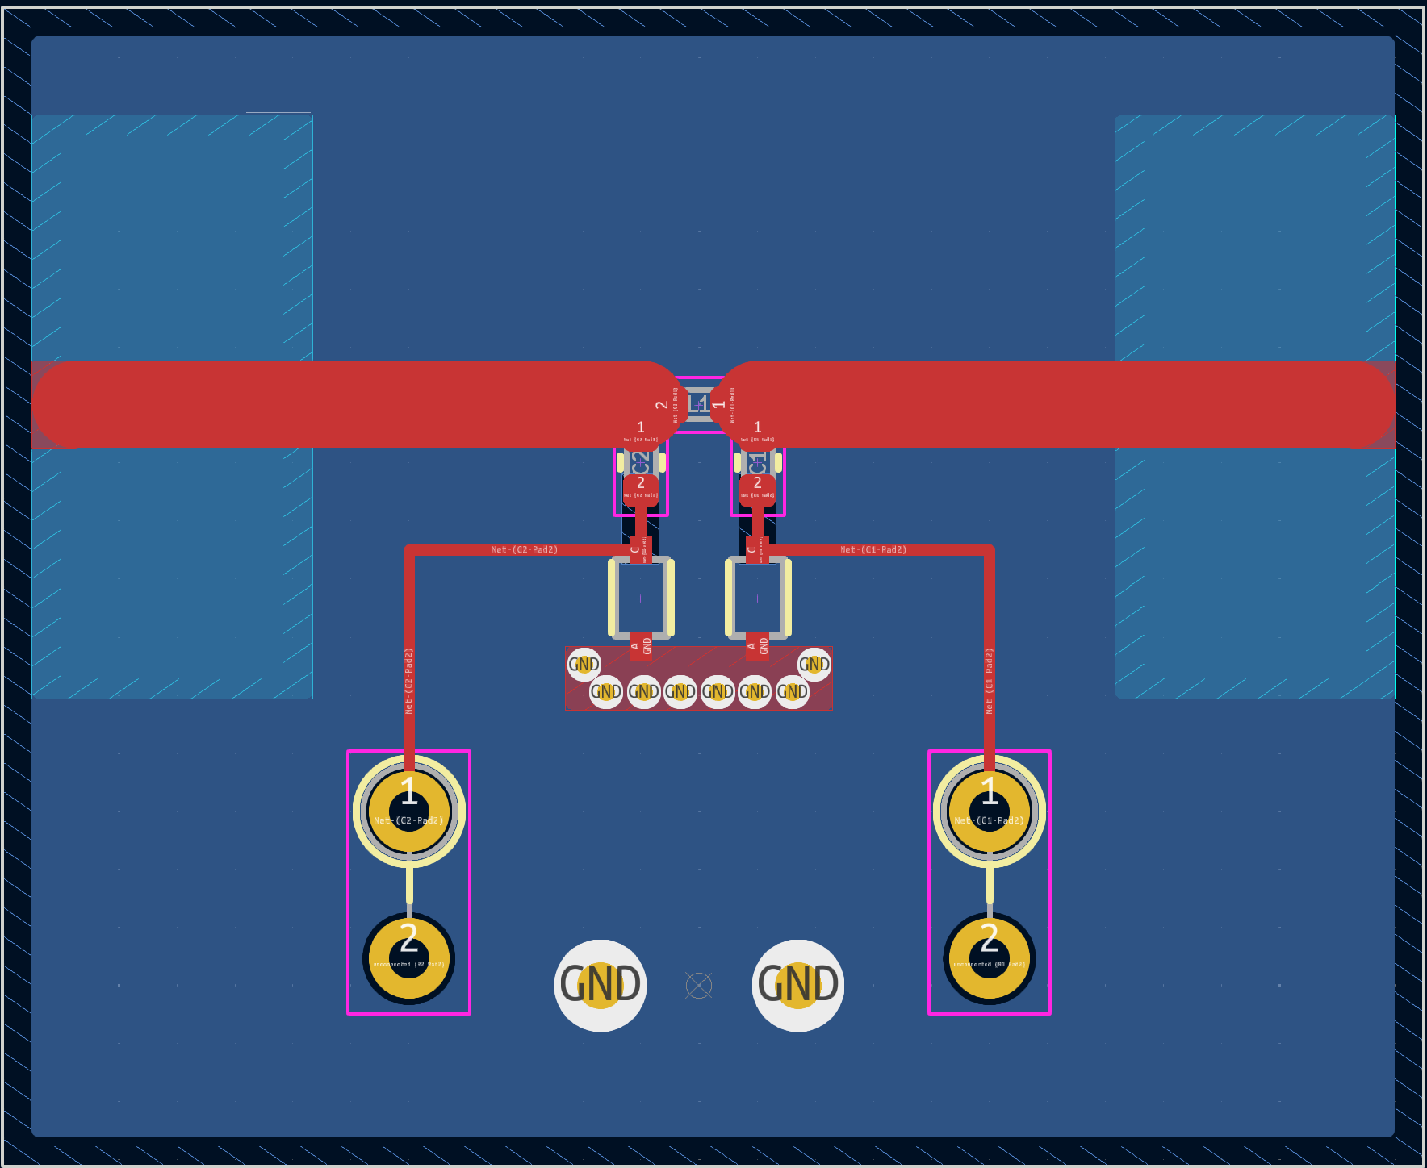
PCB Design
Special considerations in PCB design to account for stray reactances.
Multiple ground vias
Ground plane clearance
Tightly spaced components with overlapping courtyards
20mm
24.5mm
Notes:
mention challenges with DRC in kiCad
gerber files / drill files

Slide 42


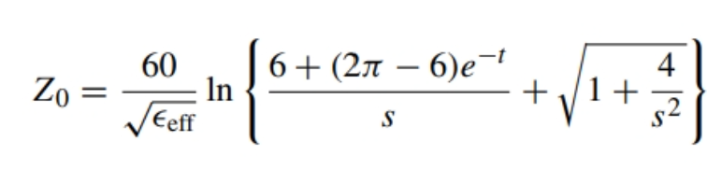
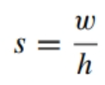
Transmission line Characteristics
The transmission line was designed to have a characteristic impedance of 50 ohms. The primary factors affecting this are:
Trace width
Dielectric thickness
Dielectric material (FR4)
  Dielectric constant vs freq
1.5 mm
0.8 mm

Slide 43
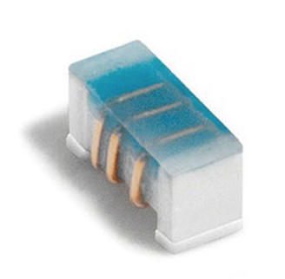
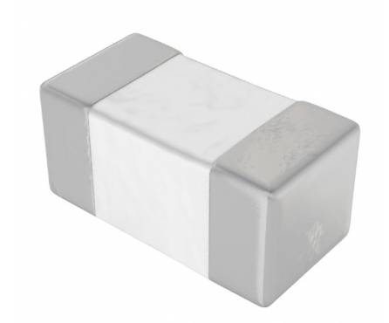
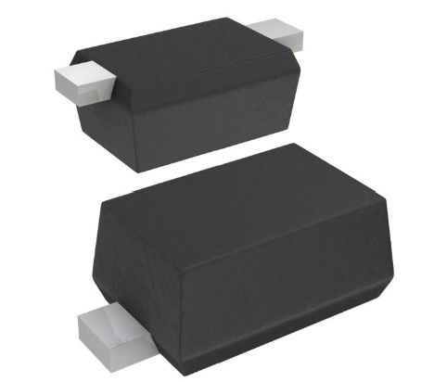
PCB Components
Inductor: Coilcraft 0402 2.2nH
Ceramic Capacitor: Johanson Tech. Inc. 0402 13pF
Varactor: Skyworks SMV1276-079LF
1.3pF to 6.85pF
Notes:
component selection based off simulation results

Slide 44
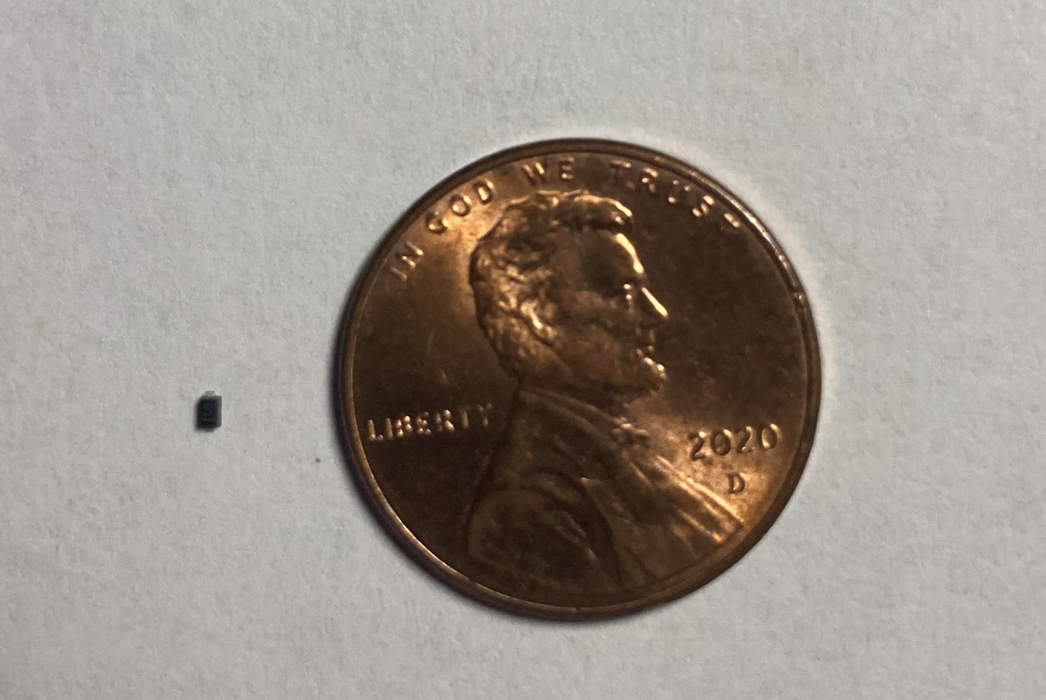
PCB Components
Notes:
component selection based off simulation results

Slide 45
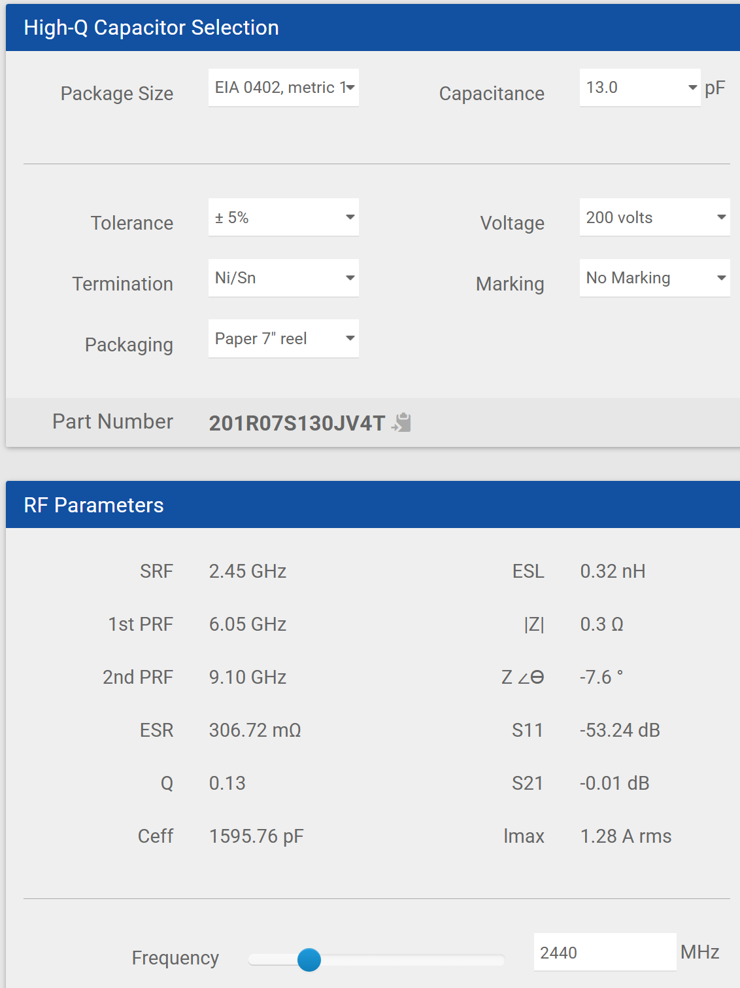
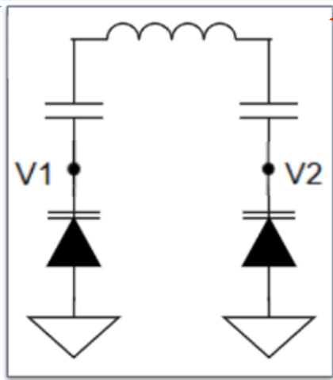
Ceramic Capacitor
Special attention was given to the selection of the DC-blocking capacitor. Ideally, the capacitor should go self-resonant at the operating frequency.
Notes:
Johanson technology Inc. provides a simulator for their components.
self resonance occurs due to the inductance inherent to any conductor

Slide 46



Ceramic Capacitor cont.
Given |Z|=3.1Ω, the reactance and effective capacitance can found by:
Recall that for series capacitors:
Our initial choice of the capacitor was based on the assumption that we would be using 2.44 GHz.

Slide 47


Ceramic Capacitor cont.

Slide 48

Finished PCB - Front

Slide 49

Finished PCB - Back

Slide 50


Measuring Insertion Loss
A full 2-port calibration was performed using a N9918A FieldFox to measure the insertion loss of the matching network @ 1.8GHz

Slide 51

Insertion Loss - Results
Insertion loss was found to be roughly 1.86dB +/- 0.09dB

Slide 52
Early Challenges
The first test at 2.44 GHz was used with a VNA and a wiFi antenna. Unfortunately, at this frequency the varactors lacked the required tuning range.
Several steps were taken to identify and correct the problem, including swapping varactors, inductors, and ceramic capacitors.

Slide 53
Troubleshooting
Varactors
  Replaced SMV1276 with SMV1247, which has slightly more tuning range, 8.86pF to 0.64pF.
Inductor
  Replaced 2.2nH inductor with 1.8nH and then 1nH. Slight improvement noticed, but not much. Even with the inductor shorted, about 1nH of inductance is still present.
Ceramic Capacitor
  Replaced both 13pF capacitors with 15pF.
Ground Plane cut outs
  Attached copper sheet to cover cut outs in ground plane to help cancel out stray inductance
Notes:
for varactors: as compared to 1.3pF to 6.85pF

Slide 54

Troubleshooting
Notes:
attempting to mitigate stray inductance by introducing more capacitance to ground

Slide 55



Troubleshooting
Inductor: 0402 1nH
Varactor:
SMV 1247-079LF
Ceramic Cap.:
0402 15pF
Load: 2.4 GHz antenna
V1
V2
Notes:
antenna part number: GW.11.A153W

Slide 56


Troubleshooting: Single Varactor
Inductor: Shorted
Varactor:
SMV 1276-079LF
Ceramic Cap.:
0402 13pF
Load: 2.4 GHz antenna
Very hard to mathematically isolate the problem!
Notes:
antenna part number: GW.11.A153W

Slide 57
Troubleshooting Results
Our testing did not immediately clarify the source of the problem when operating at 2.44 GHz.
Additional testing will be done with different varactors and a variety of loads. At the very least, a mathematical explanation can be afforded as to why the current matching network design is not feasible at 2.44 GHz.
In the interim, we have decided to proceed with our project at 1.8 GHz, which still provides some utility in wireless communications.
Notes:
mention that varactors with upper capacitance of around 22pF were considered, but higher capacitance puts SRF way below 2.44GHz, even below 1.8GHz.

Slide 58



Testing of the DACs Cont. (FT.4) [Purpose]
Calculating DAC #
Accuracy
Time response
Power consumption

Slide 59




Testing of the DACs Cont. (FT.4)
13.68mA
Software Setup
Setup: TP = Test Point

Slide 60


Testing of the DACs Results

Slide 61

Testing of the DACs Cont. (FT.4)
Time Response Software Setup:
No extra delays

Slide 62

Testing of the DACs Cont. (FT.4)
Output of DACs
Ideal Case
Each value held for ~760uS
Values offset by ~380uS
yellow trace: DAC1 output
pink trace:
DAC2 output

Slide 63

Testing SDR Can Measure Return Loss (FT. 7) [Purpose]
Testing SDR can respond to return loss changes based on different loads/open/short
Comparing results from SDR to a calibrated source

Slide 64




Testing SDR Can Measure Return Loss (FT. 7) Results

Slide 65

Testing SDR Can Measure Return Loss (FT. 7)
Setup:

Slide 66


Testing SDR Can Measure Return Loss (FT. 7) Results

Slide 67

Algorithm Outline
Our algorithm relies on discrete voltages
  30 customizable voltages for each varactor for a total of 900 possible states.
Uses a coarse-to-fine approach (2 steps) by relating varactor voltages with return loss readings
V1 Voltage | V2 Voltage
0.0 | 0.0
0.1 | 0.1
0.2 | 0.2
0.3 | 0.3
… | …
… | …
5.7 | 5.7

Slide 68

Algorithm Outline

Slide 69
Algorithm Sampling
The coarse search samples 10 points out of the 30 total for each varactor
  Notice the increasing step sizes between voltages from left to right
Creates a 10x10 array to get a rough estimation of what voltages provide the best return loss

Slide 70
Algorithm Sampling - Coarse
0
3
6
9
12
15
18
21
24
27
0
0x1A
0x0C
0x05
0x05
0x01
0xA3
0x05
0x05
0x05
0x05
The algorithm populates the table row by row, from left to right.
Row numbers correspond to V1 and column numbers to V2
3
*The next set of voltages are set, and the process repeats
*Both voltages set, some time passes to allow SDR to see change in impedance and update return loss. Sends updated return loss to PIC, which stores in first entry
0x3F
0xB6
The process then repeats for the next row, and so on until the entire table is populated by using nested for loops
6
9
12
15
18
21
24
27

Slide 71
Algorithm Sampling - Indexing
0
3
6
9
12
15
18
21
24
27
Once the table is populated, the algorithm executes an indexing function which finds the combination of voltages which gave the highest return loss
The fine-tuning portion of the algorithm narrows the scope to a 5x5 array, which then repeats the same process.
0
0x1A
0x0C
0x05
0x05
0x01
0xA3
0x05
0x05
0x05
0x05
3
0x3F
0xB6
0xC2
0xAA
0x17
0xB6
0xB6
0x45
0xB6
0xB6
6
0x1F
0xB7
0x76
0xB6
0xB6
0x77
0xB6
0xB6
0x43
0x10
9
0xB6
0x3F
0xB6
0x67
0x3D
0xB6
0xB6
0xB6
0x1E
0x15
12
0x80
0xB6
0x6C
0x4A
0xF6
…
…
…
15
18
21
24
27

Slide 72
Algorithm Sampling - Fine Tuning
V2
The exact same populating procedure is repeated for the fine tuning process, except for a 5x5 array rather than a 10x10.
An indexing function is called which finds the “best of the best” combination of varactor voltages.
7
8
9
10
11
1
2
V1
3
4
5

Slide 73
Resolution vs. Response Time
One of the key decisions in selecting our algorithm was to choose between response time and resolution
Two structures were developed: a 16x16 and a 30x30, giving resolutions of 256 and 900, respectively
We opted for the 30x30 due to superior matching characteristics

Slide 74

Completed Product

Slide 75
Completed Product
DEMO

Slide 76
Final Results
1. The device must be able to match a load impedance with a starting VSWR of 2.0 or less to within a VSWR of 1.22 (at least 20 dB return loss). Result: >20dB
2. The device (all components excluding the SDR) must have a power consumption of less than 700 mW during operation.
Result: 428mW
3.The device must be able to make adjustments autonomously when in operation. Result: Successful operation
4. The device must respond to changes in impedance within 100ms to ensure minimal delay in performance. Result: ~772ms*
5. The device must operate effectively at a frequency of 1.80 GHz. Result: Scaled down from 2.44 GHz
6. The insertion loss of the matching network should be less than 2 dB. Result: ~1.87dB +/- 0.09dB
Notes:
mention here that green means requirement satisfied, orange means we had to change the requirement at some point during development, and red means failure to satisfy the requirement.

Slide 77
Challenges and Risks: Aftermath
Challenges:
Designing a matching network that works at 2.4 GHz.
  VERY small components required, special PCB design. Had to switch to 1.8 GHz.
Designing an adaptive algorithm that responds within an acceptable time.
  Coarse-to-fine method finds a good match; limitations with GNU radio software and data transmission time limit responsiveness somewhat.
Minimizing insertion loss.
  Easily accounted for at our frequency range.
Configuring the SDR to operate in full-duplex mode and interface with MCU.
  Required installing additional drivers/libraries.

Slide 78
Challenges and Risks
Risks | Qualitative Risk Score | Mitigation Plan | Contingency Plan
Unpredictable behavior at 2.4 GHz | Likelihood = 4 (likely) Consequences = 4 (major) Total = 16 (Extreme) | Use high-quality RF components rated for 2.4 GHz. Simulate the network extensively in software. | If performance issues persist, redesign the network with alternative components or configurations.
System latency may hinder the adaptive system's real-time response. | Likelihood = 4 (likely) Consequences = 4 (major) Total = 16 (Extreme) | Thoroughly test the algorithm in simulation and simplify it as much as possible. | Redesign the algorithm
System losses are greater than what is saved | Likelihood = 2 (unlikely) Consequences = 3 (moderate) Total = 6 (moderate) | Test directional coupler directly and in series with matching network | Purchase higher-quality directional coupler
Device draws more power due to unforeseen scenarios | Likelihood = 3 (possible) Consequences = 4 (major) Total = 12 (High) | Use power-efficient components. | Redesign system with different components

Slide 79

Estimated Budget

Slide 80

Expenses

Slide 81


Estimated Schedule

Slide 82


Actual Schedule

Slide 83
This is what we are committed to complete by January –
Schedule –
Completed by January
Project Milestones
Task | Person Responsible | Projected Finish Date
Frequency Scaled Circuit Testing | James, Gilbert | Dec
Antenna testing | James, Jessie | Finished
Simulations | James, Gilbert | Jan
Selecting final components | Jessie, Gilbert | Dec
Ordering components | Jessie, Gilbert | Dec

Slide 84
Supporting Courses
Electromagnetic Theory and Applications (EE 430)
Microprocessors and system designs (EE 310)
Microelectronics (EE 334)
Internet of Things (EE 470)
Analog and Digital Communications (EE442)

Slide 85
Questions/Comments
Questions

Slide 86
References
https://www.electronicdesign.com/technologies/analog/article/21164962/electronic-design-automatic-impedance-matching-in-rf-designAccessed: Oct. 5, 2016.
Ida, I., Takada, J., Toda, T., & Oishi, Y. (2004). An adaptive impedance matching system for mobile communication antennas. IEEE Antennas and Propagation Society Symposium, 2004., 3, 3203-3206 Vol.3.
National Archives. “47 CFR Part 15 Subpart C -- Intentional Radiators.” Code of Federal Regulations,7 November 2024, https://www.ecfr.gov/current/title-47/chapter-I/subchapter-A/part-15/subpart-C. Accessed 6 November 2024.
https://www.dxengineering.com/parts/pas-hf-auto (automatic tuner image)
https://krytar.com/resources/applications/primers/directional-coupler-primer/ (coupler diagram image)
https://www.everythingrf.com/rf-calculators/directional-coupler-calculator (directional coupler formulas)

Slide 87
Additional Slides
Appendix Slides

Slide 88

Software Design

Slide 89

Algorithm Testing (FT.6)
Impedance + MN
Impedance
VSWR (MN)
23.8 - 24.1j | 16.7 + 8.9j | 3.10
71.9 + 48.3j | 19.9 - 27.4j | 3.37
56.8 - 32.6j | 19.6 - 8.7j | 3.15
22.8 + 20.4j | 93.5 + 5.5j | 1.88
Example of a simple RC load
All impedances given at 30 MHz

Slide 90

Algorithm Testing - Results (FT.6)
Initial Impedance
Initial VSWR
Final VSWR
16.7 + 8.9j | 3.10 | 2.16
19.6 -27.4 j | 3.37 | 1.81
19.6 - 8.7j | 3.15 | 2.46
93.5 + 5.5j | 1.88 | 1.15
All impedances given at 30 MHz

Slide 91


Voltage vs Capacitance
Notes:
needed to do this for increased precision, especially in the steeper parts of the graph.
Also mention how per the equation, the graph is continuous, so it is reasonable to interpolate the red values

Slide 92

Uncertainty
0 dB referenced to 15dBm

Slide 93

Uncertainty

Slide 94
IL MN

Slide 95
Response Time Testing(ST.2)
We want to confirm that our adaptive matching system can respond to impedance changes within 100 ms.
We found that the antenna starts to experience noticeable impedance changes when an object, like a hand, gets within 10 cm. So if something moves toward the antenna at around 1 meter per second, it only takes 100 milliseconds to enter that critical zone meaning our system has about 100 ms to detect the change and respond before performance is affected.
0.1 m ÷ 1 m/s = 0.1 seconds = 100 ms

Slide 96



FT232H Communication/Range
Out Of Range *
Ideal Range *

Slide 97
Initial Algorithm Testing
Algorithm Method | Pass/Fail | Code Testing | Reason for Selection or Failure
Powell | Fail | N/A | Requires complex directional math and vector updates not practical for PIC; ruled out before testing
Grid Search | Fail | Pass | Used early on to prove the system worked, but it used a brute-force approach — trying every possible DAC value one-by-one, even if the result wasn’t improving.
Hill Climbing | Fail | N/A | Similar step logic to Hooke and Jeeves but doesn’t support backtracking or pattern moves; not tested further
Hooke and Jeeves | Pass | Fail | Selected for its simple step-and-revert logic; hardcoded version worked, but automated implementation failed on PIC

Slide 98


Manual Testing of Algorithm (Pass)
Hooke and Jeeves

Slide 99

Manual Testing of Algorithm (Fail)
Grid Search

Slide 100

Manual Testing of Algorithm (Fail)
Hill Climbing

Slide 101

Manual Testing of Algorithm (Fail)
Powell

Slide 102

Best Reactive Region

Slide 103

Initial Algorithm Flow Chart (Fail)

Slide 104

Testing of the Voltage Translation Circuit (FT.5) [Results]
Output of op amp 1 before filtering:
ΔY = 85.7mV

Slide 105

Testing of the Voltage Translation Circuit (FT.5) [Results]
Output of op amp 1 after filtering:
ΔY = 26.7mV
31% improvement

Slide 106

Testing of the Voltage Translation Circuit (FT.5) [Results]
Output of op amp 2 before filtering
ΔY = 101.0mV

Slide 107

Testing of the Voltage Translation Circuit (FT.5) [Results]
Output of op amp 2 after filtering:
ΔY = 37.7mV
37% improvement

Slide 108


Relationship of Input Power vs Matching

Slide 109

Relationship of Input Power vs Matching

Slide 110

Relationship of Input Power vs Matching

Slide 111


Relationship of Input Power vs Matching

Slide 112

Relationship of Input Power vs Matching

Slide 113



Testing of the Voltage Translation Circuit (FT.5) [Purpose]

Slide 114


Testing of the Voltage Translation Circuit (FT.5)
9.20 mA
Setup: TP = Test Point

Slide 115

Testing of the Voltage Translation Circuit (FT.5) Results

Slide 116
Problem Statement
Add a slide here to briefly talk about “antenna gate” for gilberto. will help add value to proposition

Slide 117


